Slide 1


Denkei Technology R&D
Ver 8.0

Slide 2
Denkei China and Denkei Technology R&D
N
i
h
o
n
D
e
n
k
e
i
Founded in 1950, Denkei is the largest comprehensive supplier of electronic measuring instrument and environmental test equipment in Japan.
Denkei China
DENKEI TRADING (SHANGHAI)CO.,LTD
DENKEI TECHNOLOGY R&D(SHANGHAI) CO.,LTD
Denkei Trading
Started in 1996
Denkei Technology R&D Started in 2007
Equipment Sales/Repair
Calibration (cooperation)
Logistics
Customs clearance
In 2007-2009:Testing service ; Optical calibration
In 2015: Calibration service(CNAS)
In 2016: VOC Testing service
In 2017: Shanghai Pudong Testing Lab established; Three new board listing ready
In 2018: Importing New energy Testing service; Calibration service (CMA)

Slide 3
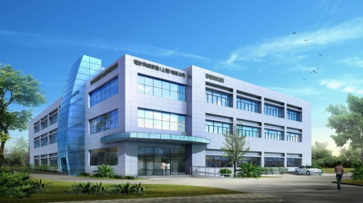
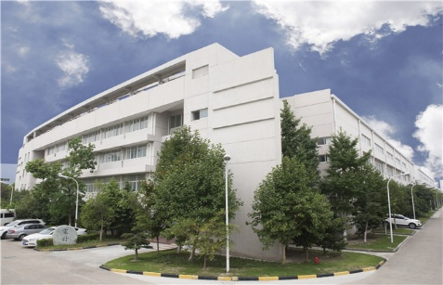

Denkei Trade and Distribution of Denkei R&D
The north region of Denkei Trade
Changchun
Denkei Technology R&D
Beijing
Dalian
Tianjin
Qingdao
Nanjing
Changshu
Minhang Testing Lab
No.609, Road Ziri, Zizhu Science Park, Minhang District, Shanghai
The west region of Denkei Trade
Wuxi
Suzhou
Wuhan
Shanghai
Chengdu
Chongqing
Hangzhou
Denkei Technology R&D
Guangzhou
Xiamen
The South region of Denkei Trade
Shenzhen
Zhuhai
Longhua
The east region of DenkeiTrade
Pudong Testing Lab
No.786,Wangqiao Road，Pudong New Area，Shanghai
Dongguan

Slide 4
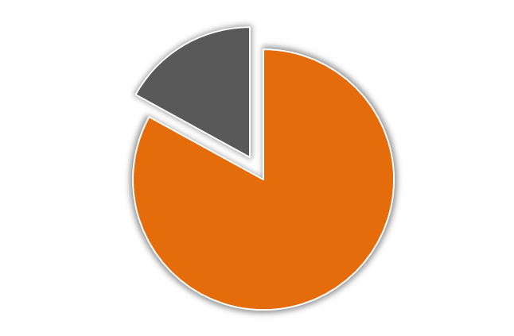
Commissioning Test Industry Distribution
Auto Industry
Auto industry test accounts
over 90%
Testing industry
Home appliance/IT
Testing
Component industry
10％
Equipment industry
Clients
Optical industry
90％
Calibration
Electronics industry
Auto industry
Environmental equipment
Others

Slide 5
Denkei R&D Equipments list
Thermal Shock
ETAC ESPEC ZUNDAR PARTNER
14sets
Temperature/Humidity
ETAC ESPEC ZUNDAR
42sets
Power Temperature Cycle
ESPEC ZUNDAR PARTNER
12sets
Combined Vibration
EMIC STI
12sets
Combined Salt-Spray
SUGA
5sets
Physical（Xenon weather/Gas corrosion
SUGA ZUNDAR社
7sets
Falling/Mechanical shock/Force-pull
SHIMAZU STI
3sets
New Energy
STI ZUNDAR Dlgatron MKLtech SUGA
35sets
Electric
KIKUSUI HIOKI TEKTRONIX GRAPHTEC NOISKEN
35sets

Slide 6
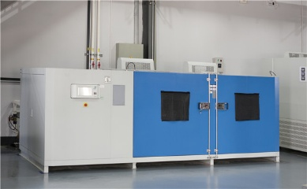
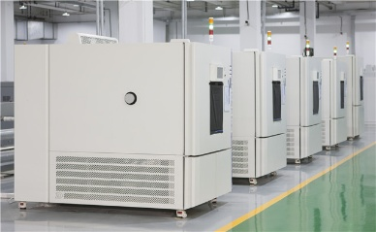
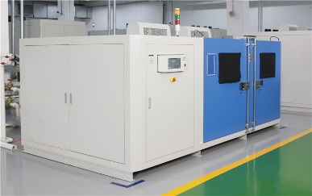
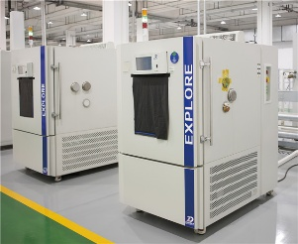

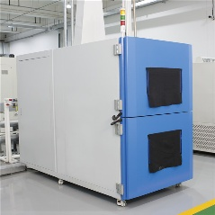
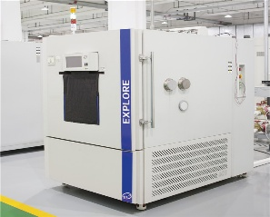
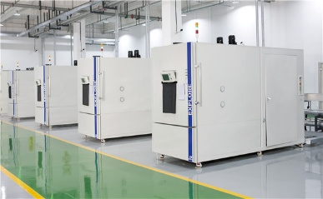
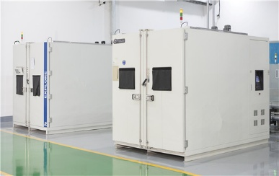
Pudong - Environmental Lab
Test Item | Photo | Test Item | Photo
Thermal Shock |  | Low Temperature & Humidity
 |  | Dewing Test
Power Temperture Cycling Test |  | Low & High Temperature – Walking Chamber
Environmental equipment
19 sets

Slide 7
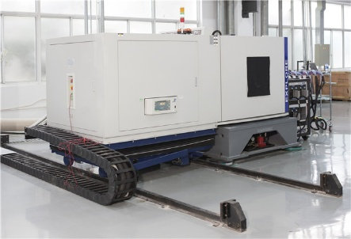
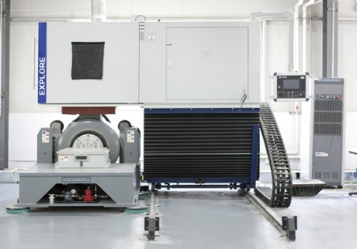
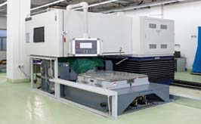
Pudong - Vibration Lab
Test Item | Photo
Vibration Test (Sinusoidal, Random and Shock Test) Combined Enviroment Test
Vibration Equipment: 5 sets
Compound Vibration Equipment:
5 sets
◆ 5T * 1set
◆ 6T * 2set
◆ 8T * 1set
◆ 12T * 1set

Slide 8
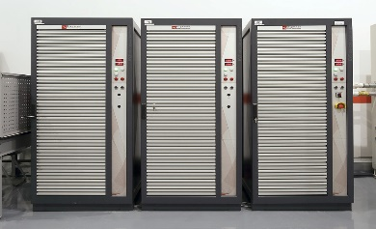
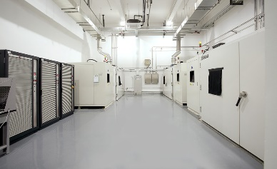
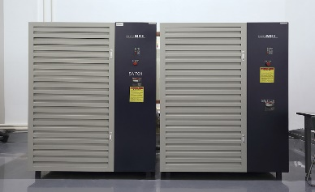
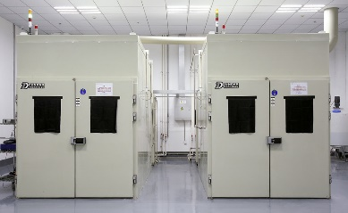
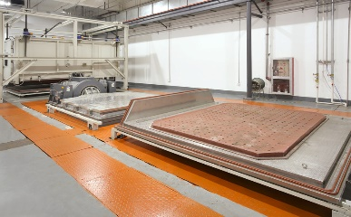
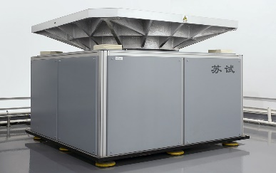
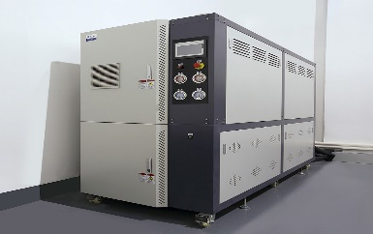
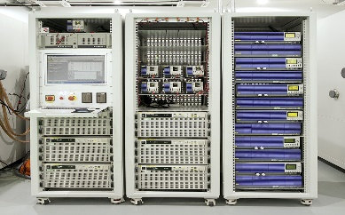
Pudong – New energy Lab-1
Test Item | Photo | Test Item | Photo
Power Battery Assembly Charge-Discharge Test |  | Power Temperature Cycle Chamber
 |  | Salt-Spray
20T Combined Viration |  | Mechanical Shock
Cooling System |  | New Energy Power Supplies /Electronic load
New equipment
14sets
Test object
Power battery
Electric machinery
Electronic control

Slide 9
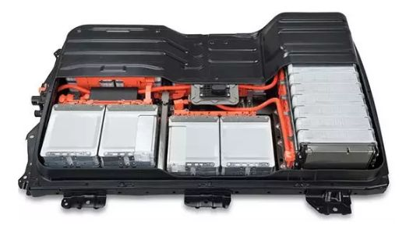
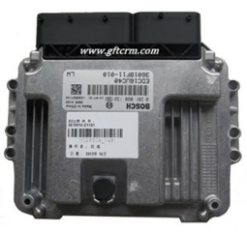
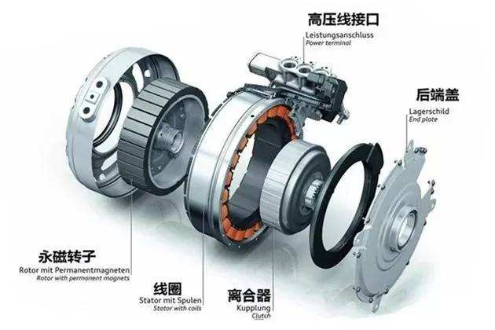
Pudong – New energy Lab-2
Power battery Test
Electronic control Test
Electric machinery Test
Complete reliability and performance test configuration for new energy
Test Item：
Electrical performance testing: capacity, energy testing, working condition simulation, life cycle...
Environment Test： Thermal Shock test， Temperature & Humidity test， Salt Spray test…
Safety Testing: Overcharge/Overdischarge Protection, Vibration test, Impact testing…

Slide 10
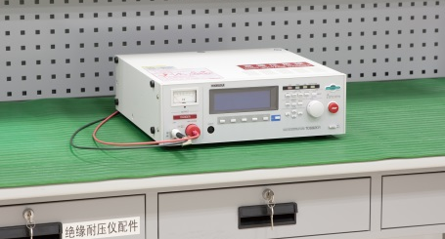
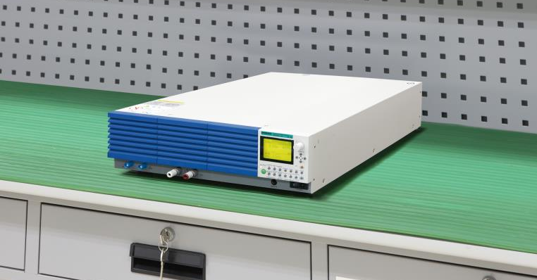
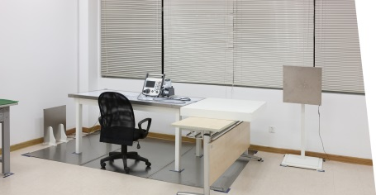
Pudong - Electrical Lab
Test Item | Photo
Withstand voltage / insulation resistance test
Electric Property test
ESD (Electronic Static Discharge)

Slide 11
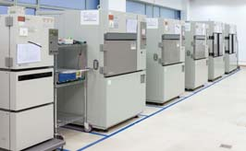
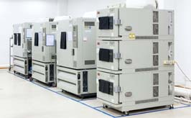
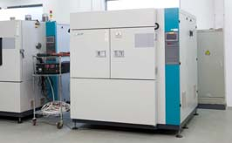
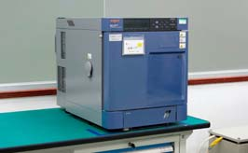
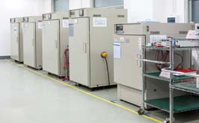
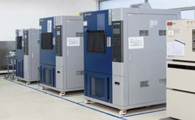
Minhang - Environmental Lab-1
Test Item | Photo | Test Item | Photo
Thermal Shock |  | Low Temperature & Humidity
High Temperature Test
Environmental laboratory
4 rooms
Environmental equipment
43 sets

Slide 12
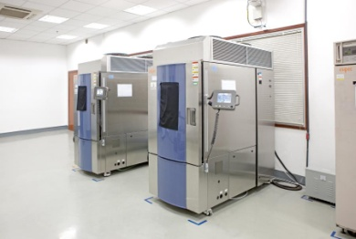
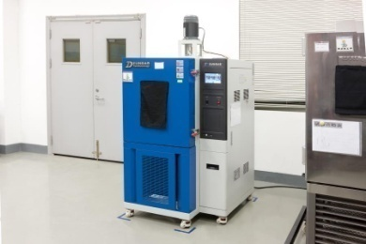
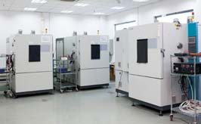
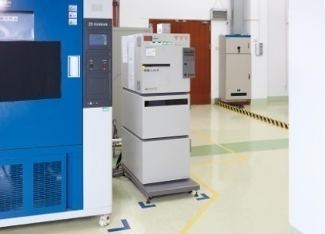
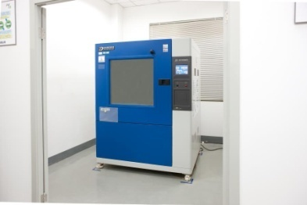
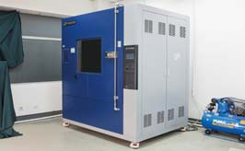
Minhang - Environmental Lab-2
Test Item | Photo | Test Item | Photo
Power Temperture Cycling Test |  | Low Pressure Test
 |  | HAST Test
IEC/ISO Dust Test |  | Water Test IPX1~X4K JIS R1R2S1S2 IPX9K

Slide 13
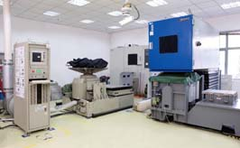
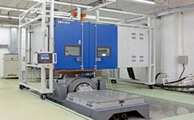
Minhang - Vibration/Mechanical Shock Lab-1
Test Item | Photo
Vibration Test (Sinusoidal, Random and Shock Test) Combined Enviroment Test
Vibration Laboratory: 2 rooms
Mechanical Laboratory: 1 room
Large-scale Mechanical
Test Equipment:
15 sets
Vibration Equipment: 6 sets
Compound Vibration Equipment:
6 sets
◆ 0.3T * 1set
◆ 3T * 1set
◆ 5T * 2sets
◆ 6T * 1set
◆ 12T * 1set

Slide 14
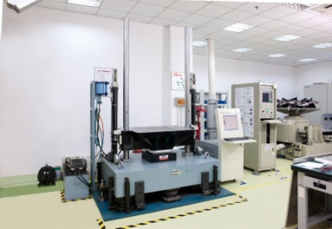
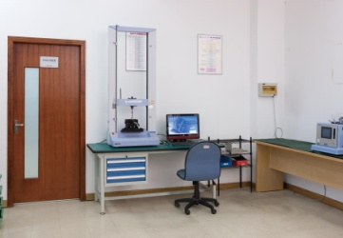
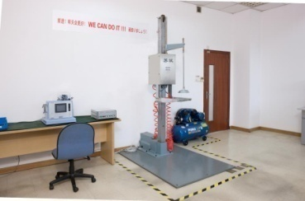
Minhang - Vibration/Mechanical Shock Lab-2
Test Item | Photo
Mechanical Shock Test
Force - Pull Test
Falling Test

Slide 15
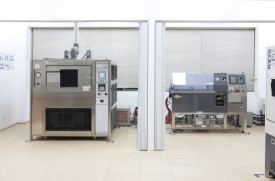
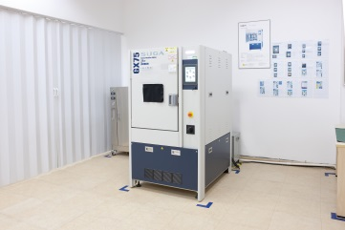
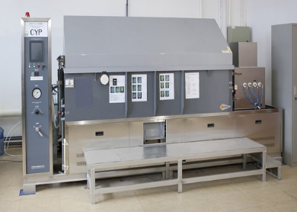
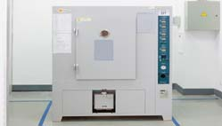
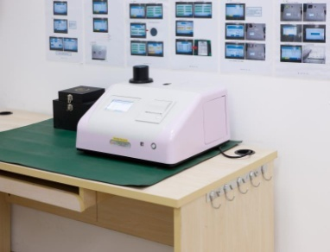

Minhang - SUGA Lab
Test Item | Photo | Test Item | Photo
Salt Spray Test (Neutral) Combined Cyclic Corrosion Test(Neutral) |  | Xenon Weather Test
 |  | JIS Dust Test
Colorimeter |  | Flowing Mixed Gas Gorrosion Test
SUGA laboratory
2 rooms
Test Equipment:
7 sets
◆ Combined Cyclic
Corrosion Test
Equipment:1set
◆ Xenon Weather Test
Equipment:1set
◆ JIS Dust Test
Equipment:1set
◆ Flowing Mixed Gas
Gorrosion Test
Equipment:1set

Slide 16








Minhang - VOC Lab
Test Item | Photo | Test Item | Photo
Sample Prepare Collect Analysis |  | Environment Chamber 24m³ Chamber
 |  | Date Analysis TDS-GC/MS * ＡＧＬＩＥＮＴ * ＳＨＩＭＡＤＺＵ
 |  | Date Analysis HPLC
2016:VOC Test
(Bag method)
Main Supplier
◆ SHIMADZU-GL
◆ ESPEC
◆ AGLIENT
◆ SHIMADZU

Slide 17

Minhang - Calibration Lab
Lab |  | Calibration Item
WAVETECH GRAPHTEC，MINATO |  | Copying meter
 |  | Data Recorder
CNAS Calibration | Calibration Project | Digital Multimeter | DC/AC Voltage & Current
 |  |  | Resistance
 |  | DC Standard Voltage Generator | DC Voltage
 |  | Environmental Test Equipment | Temp & Hum
 |  | Data Recorder | Temp & Hum
 |  | Universal Testing Instrument | Load capacity
 | 2019 (Plan) | DC Standard Current Generator | DC Current
 |  | Salt spray test equipment

Slide 18



Minhang - Optical Calibration Lab
Co-established by Denkei R&D and TOPCON
It is the unique luminance meter and illuminance meter calibration center in Mainland China.
Calibration
Adjustment
Repair
Equipment leasing
Training on operation
Calibration range and basis
Calibration range | 0.005 cd/m2 ～ 40,000 cd/m2
Calibration basis | Japan | TOPCON Manufacturer Standard

Slide 19





Mass Properties– RESONIC Cooperation
To determine the mass properties (center of gravity, COG, moments of inertia, MOI, and products of inertia, POI) of test objects.
COS
MOI
POI
Measurement Procedure
1 | Prepare machine
2 | Prepare mass property measurement
3 | Perform mass property measurement
4 | load measurement results (test object + empty measurement), load coordinate transformation, save overall result, alternatively load batch file.
Signal
Center of Gravity position (COG)
Calculation

Slide 20











JFE-TEC Cooperation
Solving technical problems in China
Material analysis
Structural investigation of automotive body
Performance Electric Machines
Cooperation Plan (Conceptual Stage)
2018
2019
2020
Market Research
Laboratory Preparation
Start of Project Operation
JV Consultation

Slide 21






Failure analysis - Shanghai Jiao Tong University
Analysis Item
- EDS
- Hardness Test
- Elemental Analysis
- Metallographic Test
- Welding Strength test
- Thickness Measurement
……
Equipment:
Test Example:

Slide 22

Denkei Technology R&D Framework
Testing Center
Calibration Center
Manage
- ment
Reliability Test
New Energy Test
Electrical Test
Pudong Testing Lab
Optical
Electrical
Reliability
Technical Support
Customer Contact
Project Engineer
Customer Contact
Project Engineer
Test Engineer
Test Support
Calibration Engineer
Calibration Engineer
Calibration Engineer
Marketing project import
VOC Test
Quality Represent-ative
Management of equipment and instruments
Test Engineer
New Energy Director
Test Engineer
Quality Representative
Technical -Support Engineer
Technical -Support Engineer
ISO / System Management Representative
By Feb, 2019
Personnel：54

Slide 23

Intelligent Laboratory Management-1
Accurate data
Information Publicity
LIMS System Management
Business Management
Business quotation Contract Assessment Client Management
Testing Management
Reports Management
Reports Approval
Finances Management
Lab Management
Standards Management Facilities Management
Data Query
Data Entry Test Duties Equipment Planning
Charge Record Account Management Price Management
Contract Inquiry Samples Inquiry Reports Inquiry

Slide 24

Intelligent Laboratory Management-2
IOT System Management
Action in2019

Slide 25


Intelligent Laboratory Management-2
Action in2019
IOT System Management
Laboratory Intranet
Internet
Internal
management
DA Server
Storage Server
VOD
Laboratory 1
Cloud server
Test query
Cloud database
DA Server
Internal
management
Storage Server
Laboratory 2

Slide 26




Denkei Technology R&D Certificates
ISO/IEC 17025 Certificate
Certificate No: CNAS L3746
CMA
VW Certificate
High-tech enterprises

Slide 27
Development History and Future Development
2007
2013
2015
2017
2018
2019
Complete originally testing equipment imported of infrastructure
Authorized by Electrical Calibration
Pudong Tesing Lab establishment
Increasing new energy test investment
Metallographical Test
(cooperation)
Extend by Temp & Hum Calibration
Listing New Third Board
Imported lab system management
CATARC
Co-operation
Authorized by VW Certificate
Officially Opened
New energy vehicle test item import
2nd stage of the project
Importing large Test instrument
Imported:
● Mixed gas test equipment
●JIS standard of dust equipment
●IP9K equipment
● Walking chamber.
Importing JFE-TEC
Co-operation
Authorized by ISO17025
Authorized by CMA
Establish VOC Lab
VOC Authorized by CNAS & Auto Certificate
Imported Salt spray Test instrument
Imported lab system management
Importing IOT System management

Slide 28

Denkei Technology R&D Quality Policy
1
Fair behavior
Our target
Scientific methods
2
To be Lab with Trust, Respect for client.
3
Standardized service
Quality Service
Professional level
4
Sound system
5
Continuous improvement

Slide 29







Guo Fei Fan
Contact
021-58205887-104/18601667987
021-34293305
Denkei_rnd@c-denkei.cn
No.609, Ziri Road, Zizhu Science Park, Minhang District, Shanghai
http://www.sh-denkei-rnd.cn

